Slide 1


Year 9 GCSE Options
Making Decisions – connecting the DOTS

Slide 2




How do define a career?
Traditionally, people have thought of a career as staying in or moving upwards through a specific job. A better way of thinking about a career is a journey, which can take different directions.

Slide 3








What makes up a career journey?
Jobs/work experience
Enterprise activities
Education
Qualifications
Volunteering
Your interests
Achievements
Your skills

Slide 4
Where to start? – Your Education and GCSE options
Important questions to ask yourself:
What career aspirations do you have?
Which subjects will help you achieve your ambitions?
Are the courses suited to you?
Will your choices keep your options open?

Slide 5
Who can help?
Y9 options booklet
Y9 options evening
Careers Advisor – Miss Gallagher
Unifrog
Form tutors
Subject tutors
Parents

Slide 6
The core subjects
English language
English literature
Maths
Science
Social Studies

Slide 7
GCSE Option subjects
Statistics
Geography
Spanish
French
Music
Food
IMedia
Construction
Health & Social Care
ESOL
Motor vehicles
Salon
Business
Sport
History
Art
Performing Arts
Computer Science

Slide 8
Qulaification Type and Grades
GCSE | BTEC
Grades 1-9 | Grades pass. Merit distinction at level 1 or 2
Mostly assessed by final written paper, some have coursework | Assessed by a mixture of coursework and practical, plus final written paper
Requires the retention of knowledge, application of skills learnt during course | Requires the retention of knowledge, application of skills learnt during course.

Slide 9

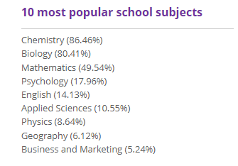
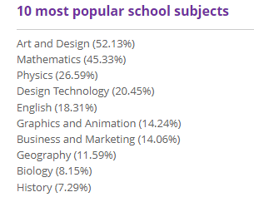
Choosing your options
Route 1 – you know which job/industry you are interested in after school
Pharmacy
Architecture

Slide 10
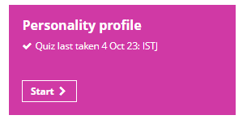


Choosing your options
Route 2 – you have no idea what you are interested in after school

Slide 11
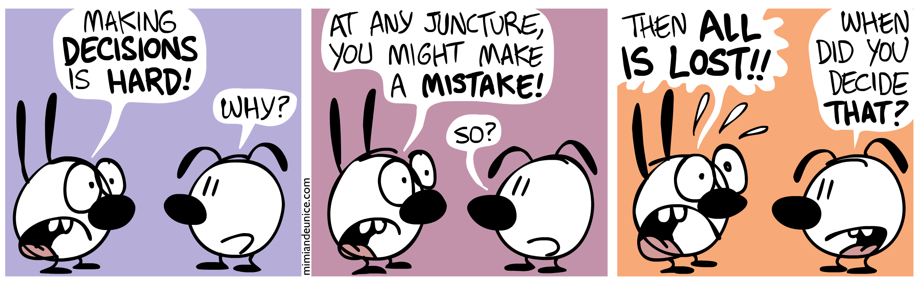
Things to consider
Most careers of interest are covered by your core subjects, so most doors remain open
If you would like a creative or practical career, make sure you choose at least one creative option

Slide 12
Making Decisions
Do choose a course because: | Don’t choose a course because:
It fits your interests and abilities | Your friends have chosen it
You are good at it and think you will enjoy it and do well | Someone else thinks it will be a good idea for you to do it
It links to a career of interest | You think it will be easy
You think you might want to study it further after year 11 | You think it’s a good course for your gender to take
It will help you meet the entry requirements for post-16 options | You don’t have time to research your options so just pick anything
It will give you more choices/option later on | You like the teacher you have now

Slide 13

Other helpful websites…
Careerpilot : Get information : Your choices at 14 : Choosing GCSEs: compulsory and optional
Choosing your GCSE options - icould
Choosing GCSE Options | Studential.com

Slide 14

Any Questions?....or pop and see me in careers office or at Options evening tomorrow

Slide 15
Emilie Wapnick: Why some of us don't have one true calling | TED Talk

