Slide 1















OPTIONS
OPPORTUNITIES
POST 16 & 18
created in partnership with

Slide 2




There are 3 things to consider when thinking about what options to pick in your next stage of education
What you enjoy
____
What subjects or topics particularly interest you and you enjoy learning more about?
Your Strengths
____
Things you’re naturally good at
Your Skills
____
Things you have learnt to be good
at over time

Slide 3
Routes and Qualification Levels
Level 8
7
6
5
4
3
2
1
Doctorate/PhD
Master Degree / Post Graduate Certificate / Post Graduate Diploma
Degree
Diploma of Higher Education (DipHE)
Foundation Degree / Certificate of Higher Education (CertHE)
A Levels/ AS Levels
GCSE Grades 9-4
Traineeship / GCSE Grades 1-3
Doctorate/PhD
Master Degree / Post Grad Certificate / Post Grad Diploma
Degree / Graduate Certificate / Graduate Diploma
Levels/Award/Certificate Diploma Higher National Diploma (HNP) Foundation Degree
Level 4 Award, Certificate or Diploma / Higher National Certificate (HNC)
Level 3 Award / Certificate Diploma T-Level / BTEC
Level 2 Award / Certificate Diploma / BTEC
Traineeship
Higher Apprenticeship (L8)
Degree Apprenticeship (L7) Higher Apprenticeship (L7)
Degree Apprenticeship (L6) Higher Apprenticeship (L6)
Higher Apprenticeship (L5)
Higher Apprenticeship (L4)
Advanced L3 Apprenticeship
Intermediate L2 Apprenticeship
Traineeship
SKILLS FOR LIFE

Slide 4

The Academic Route
Involves taking A Levels at sixth form or college
What subjects do you think you could be studying if you took
A Levels?
Notes:
Study type is mainly exams at the end of a two year study period.

Slide 5
Typical ‘A’ Level Subjects
Accounting
Biology
Business
Chemistry
Classical Civilisation
Computing
Economics
English Language
English Literature
Environmental Studies
French
Geography
Government & Politics
Health & Social Care
History
ICT
Law
Mathematics
Media Studies
Music
Philosophy
PE
Physics
Psychology
Religious Studies
Sociology
Spanish
Notes:
Subjects include traditional subjects (including those you may be studying now) and well as new ones like economics, psychology, geology etc.
Typically need at least 5 GGSE grades 4/5 upwards and often 6s in the subjects you want to take at A Level.
Most learners take 3 subjects, but it can be possible to take 4.
Most learners progress to university, but apprenticeships and other routes are also available.

Slide 6

The Technical Route
Involves taking T Levels or BTECs, available at colleges and some sixth forms.
What subjects do you think you could be studying if you took T Levels or BTECs?
Notes:
Learners progress to apprenticeships, university or straight into employment.

Slide 7
Typical ‘T’ Level / BTEC Subjects
Accounting & Finance
Agriculture
Applied Science
Art & Design
Biology
Business
Chemistry
Engineering
English
Health & Social Care
History
ICT
Law
Leisure & Tourism
Mathematics
Performing Arts
Psychology
Science
Sport Science
Travel & Tourism
Uniformed Public Services
Notes:
T Levels are new, include 45 days work experience and have been designed by employers. T Levels will eventually take over from BTECs.
Study type is mainly course/project work continuously assessed over the two year course, though there are also some exams too.
Wide range of subjects available, though more work sector focussed e.g. Business, Health and Social Care, Engineering etc.
Typically need at least 4 GGSE grades 4 for a level 3 (A Level equivalent), though level 2 courses can be accessed with lower grades.
Learners will take one subject.

Slide 8

The Work-Based/
Apprenticeship Route
Involves finding employment and working towards an:
Intermediate Apprenticeship (Level 2)
or
Advanced Apprenticeship (Level 3)
Notes:
Most of the week will be in the workplace with 1 day per week or a block placement at college.
Study type is mainly evidence showing that you have the knowledge and skills needed for the job.
Apprenticeships are now available in a wide range of subject areas and can lead to higher and degree level apprenticeships.
You get paid while you do an apprenticeship with a wage of approximately
£150+ per week.
Search here for live Vacancies: https://www.findapprenticeship.service.gov.uk/

Slide 9
Typical Apprenticeship Subject Areas
Animal Care
Agriculture
Business & Administration
Care Services
Catering & Hospitality
Construction
Creativity & Design
Digital
Education & Childcare
Engineering & Manufacturing
Hair & Beauty
Health & Science
Legal & Finance
Sales & Marketing
Transport & Logistics
Notes:
Most of the week will be in the workplace with 1 day per week or a block placement at college.
Study type is mainly evidence showing that you have the knowledge and skills needed for the job.
Apprenticeships are now available in a wide range of subject areas and can lead to higher and degree level apprenticeships.
You get paid while you do an apprenticeship with a wage of approximately
£150+ per week.
Search here for live Vacancies: https://www.findapprenticeship.service.gov.uk/

Slide 10



So, what about Post 18?
Let’s talk about the opportunities available to you after you turn 18…

Slide 11







Higher Education
Work
Gap Year
Start a Business
Degree Apprenticeship
Do Nothing
Notes:
These are the most common options Post 18
Taking a Gap year is not a year ‘doing’. This needs careful consideration and planning to spend the time wisely.
If students choose ‘do nothing’, what will be the outcome?

Slide 12




Research Resources
Apprenticeships
www.gov.uk/apply-apprenticeship
BTEC’s and T-Levels
https://www.tlevels.gov.uk/students
www.ucas.com
www.theuniguide.co.uk
www.whatuni.com
Higher Education

Slide 13

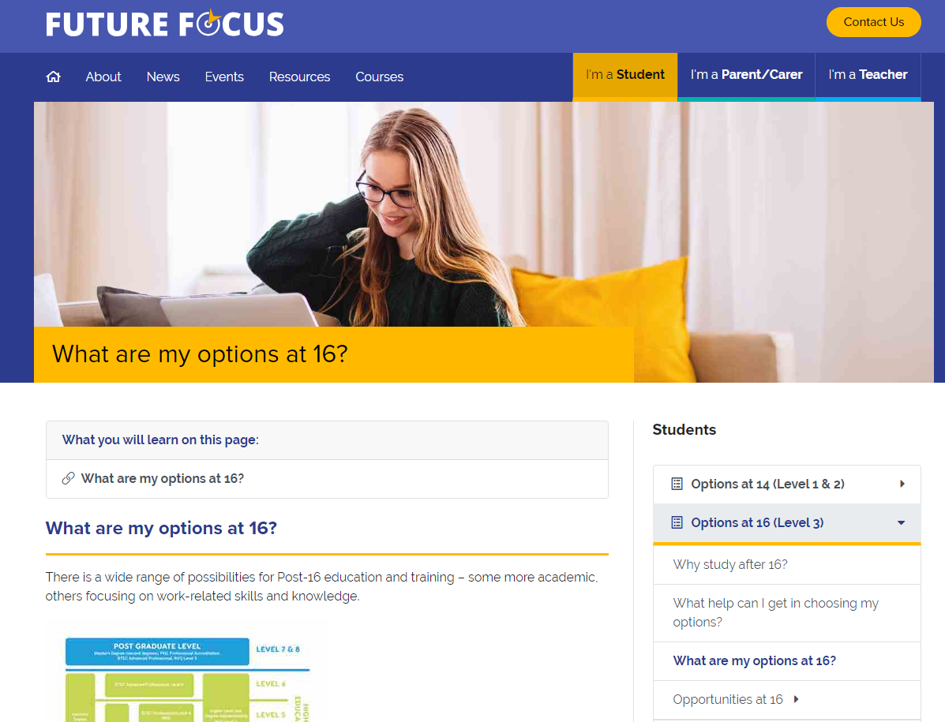
created in partnership with

